Slide 1
Introduction to OASYS
overview of OASYS and its main features
Luca Rebuffi (ANL)

Slide 2
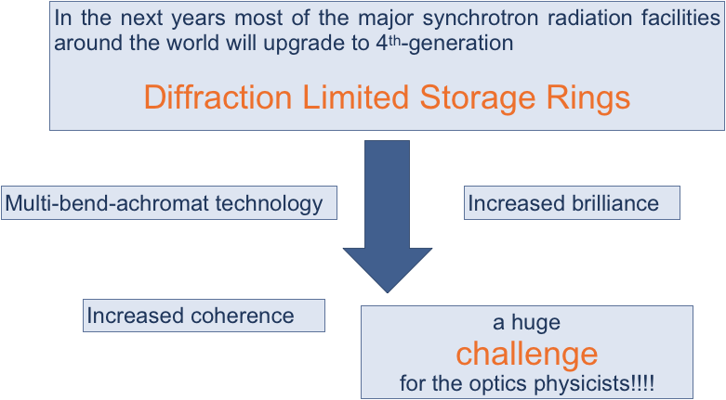
Introduction to OASYS – 10 years ago……

Slide 3
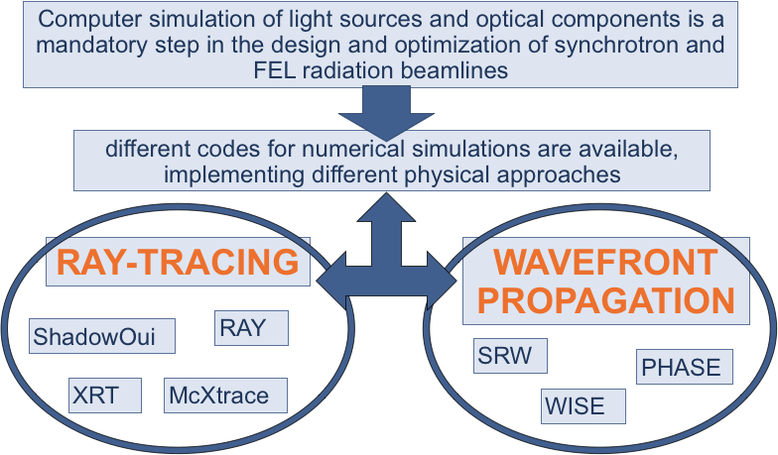
Introduction to OASYS – 10 years ago……

Slide 4
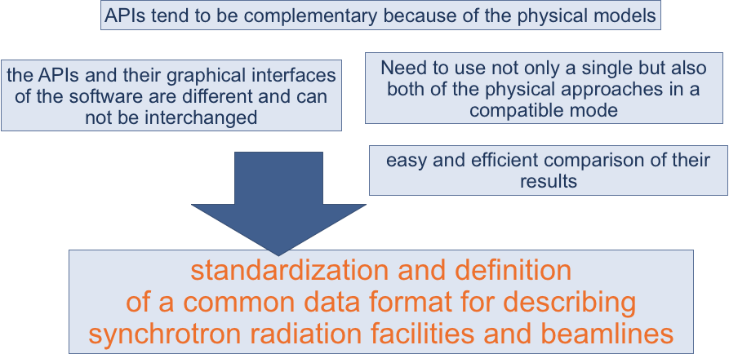
Introduction to OASYS – 10 years ago……

Slide 5
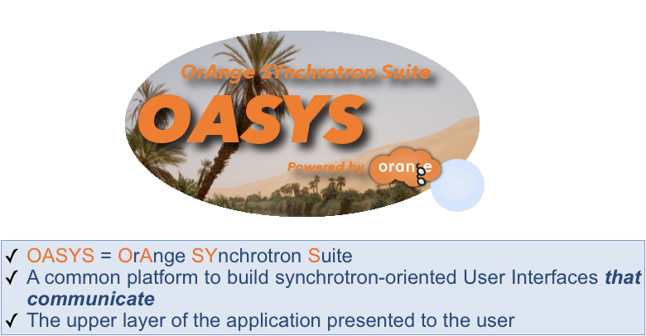
Introduction to OASYS – 10 years ago….
https://www.youtube.com/watch?v=XP1LJzRTdng

Slide 6
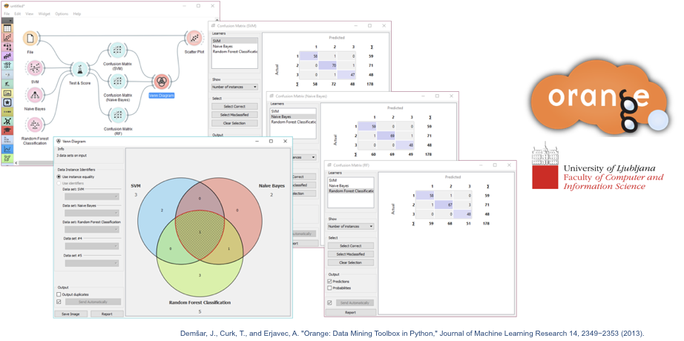
Introduction to OASYS

Slide 7
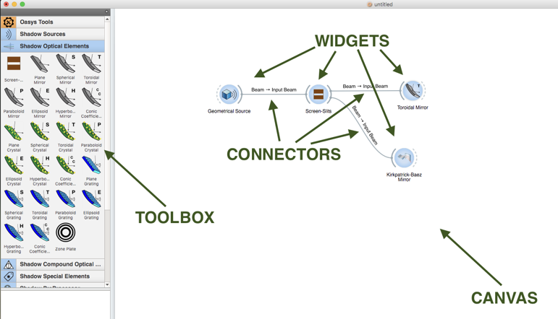
Introduction to OASYS

Slide 8
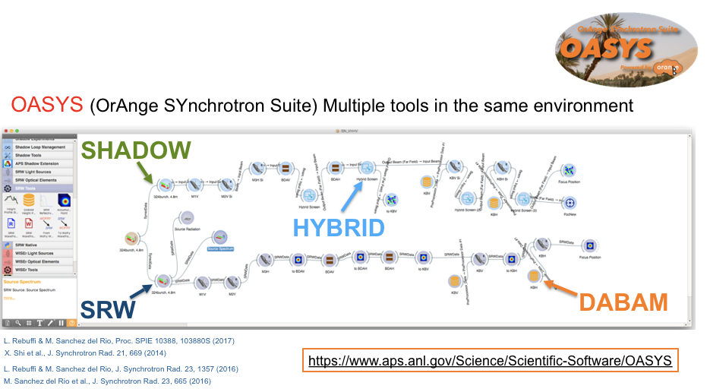
Introduction to OASYS

Slide 9
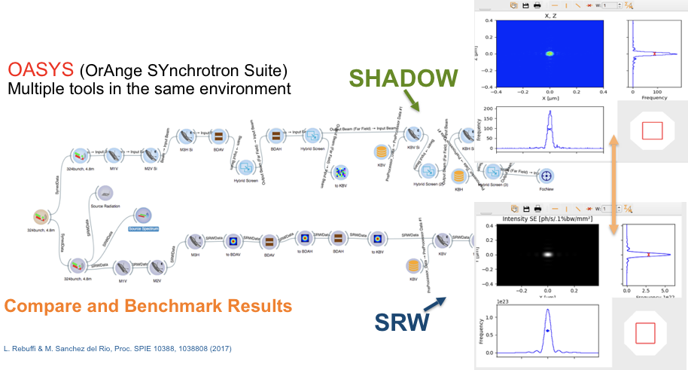
Introduction to OASYS

Slide 10
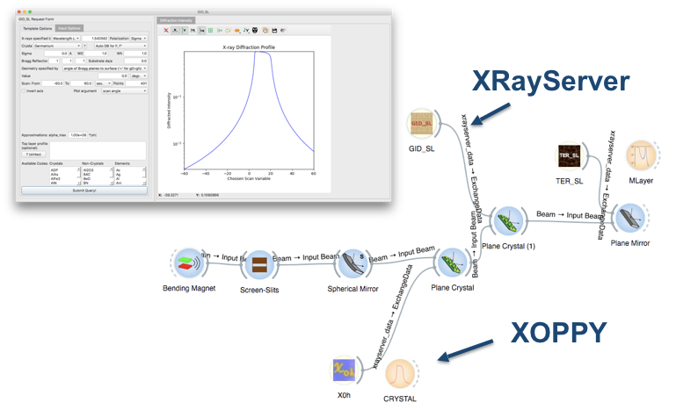
Introduction to OASYS
EASILY USE AND COMBINE WELL-KNOWN POWERFUL TOOL

Slide 11
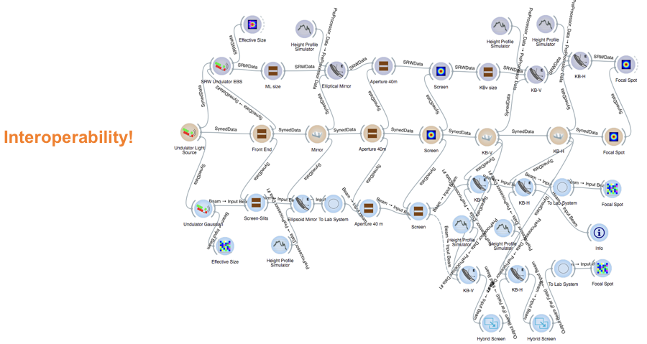
Introduction to OASYS

Slide 12
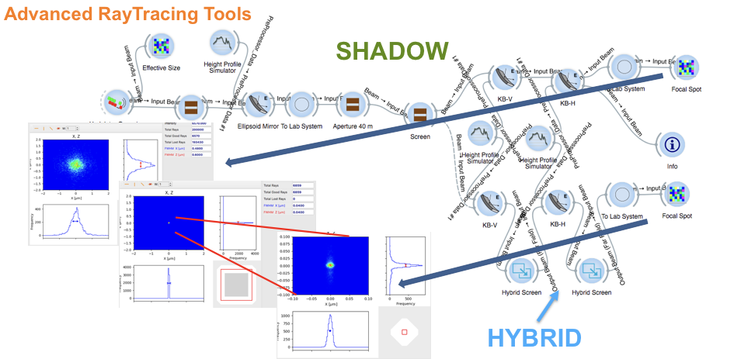
Introduction to OASYS

Slide 13
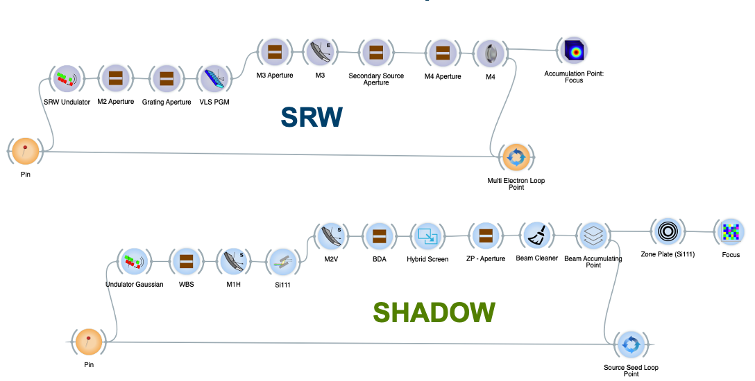
Introduction to OASYS
LOOPS

Slide 14
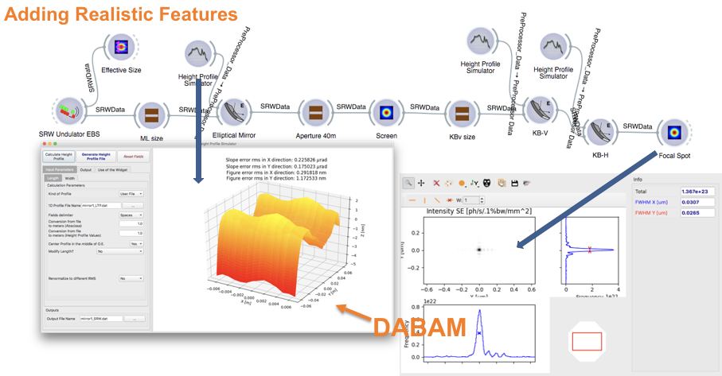
Introduction to OASYS
Surface Errors of Mirrors

Slide 15
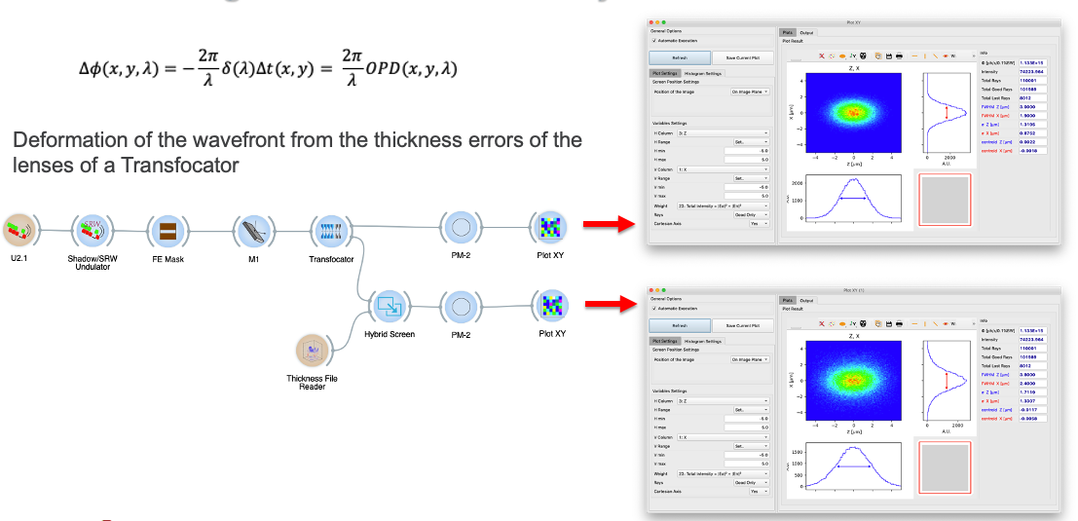
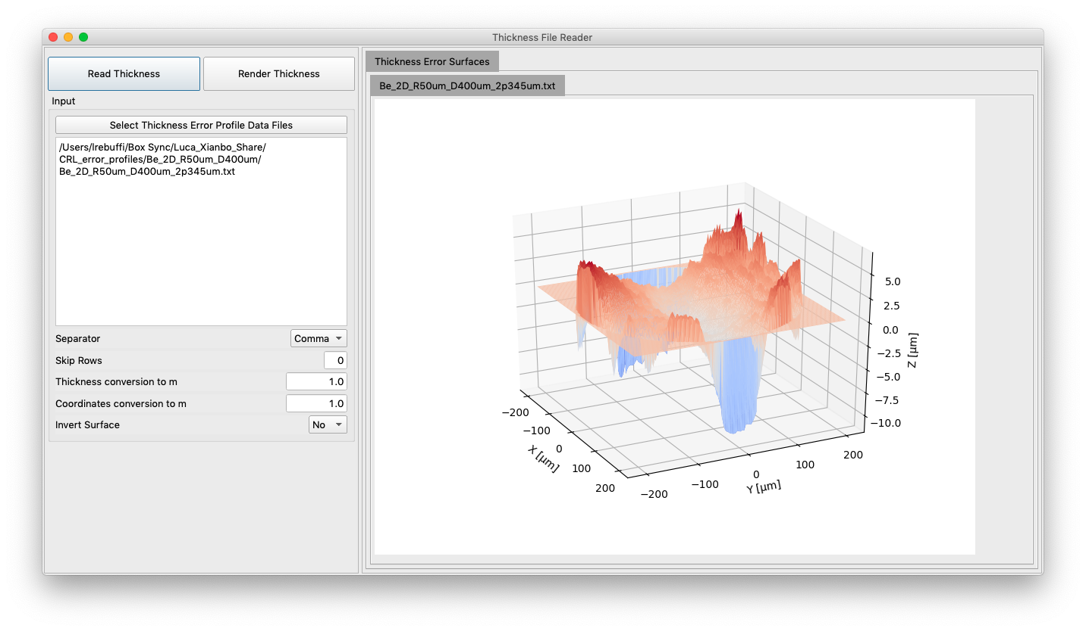
Introduction to OASYS
Thickness Error Profiles for CRLs

Slide 16
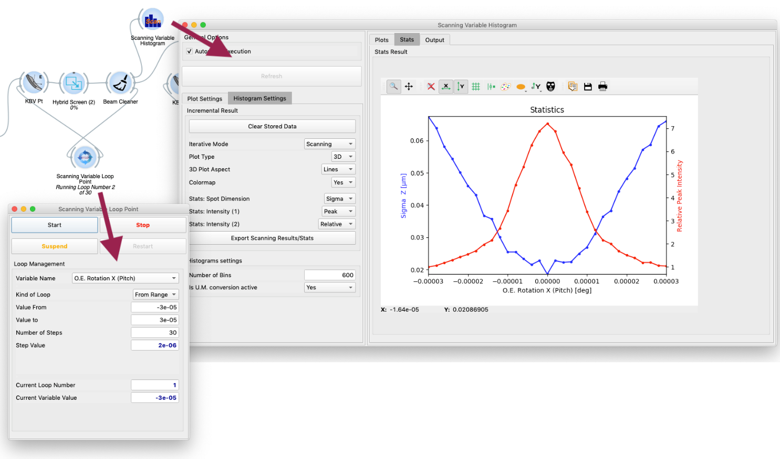
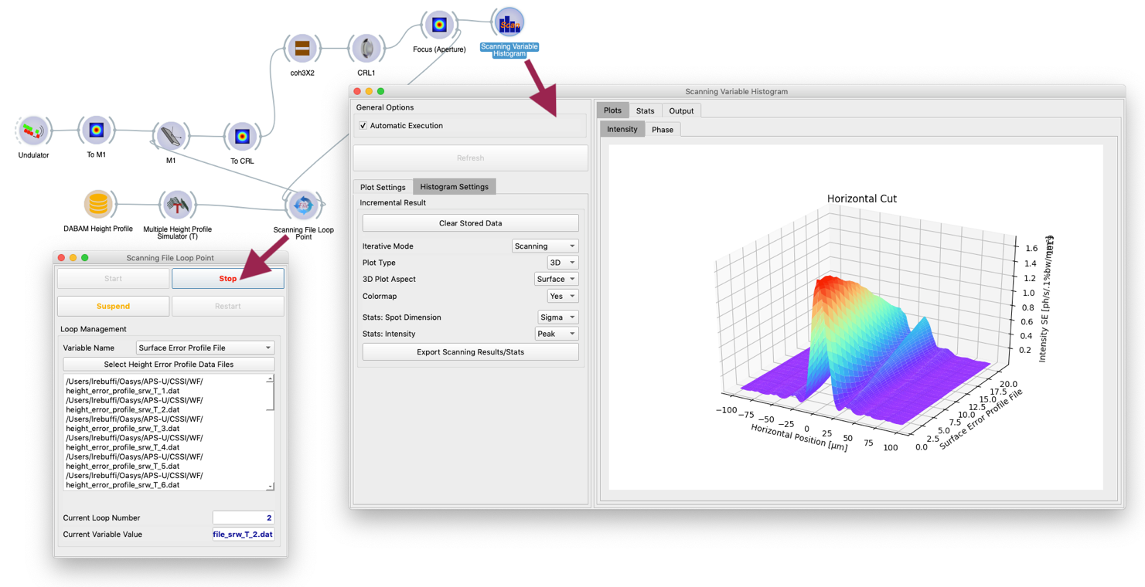
Introduction to OASYS
Advanced Loops for Optical Specifications

Slide 17
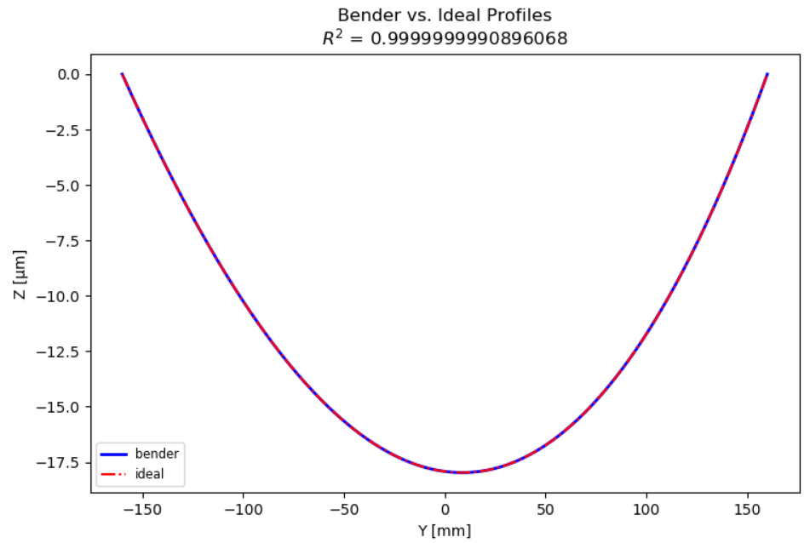
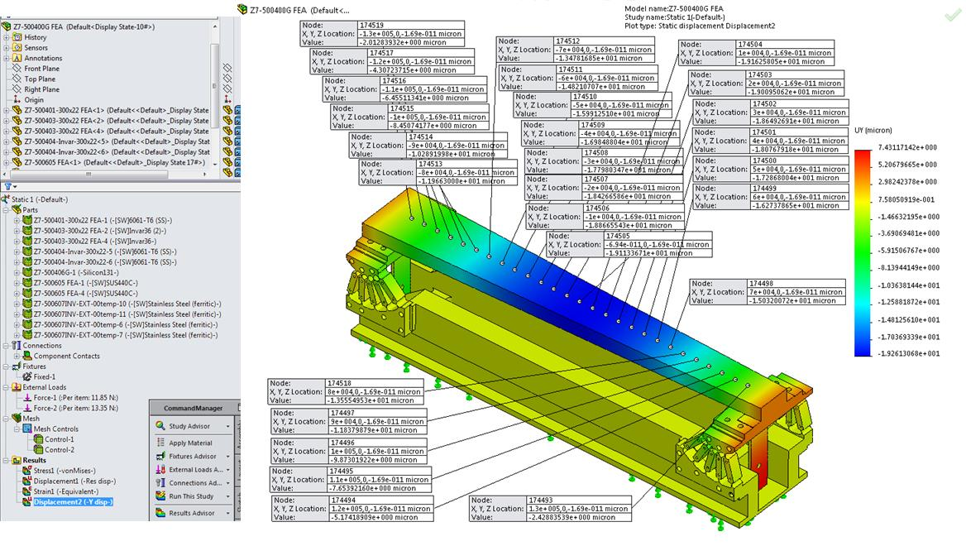
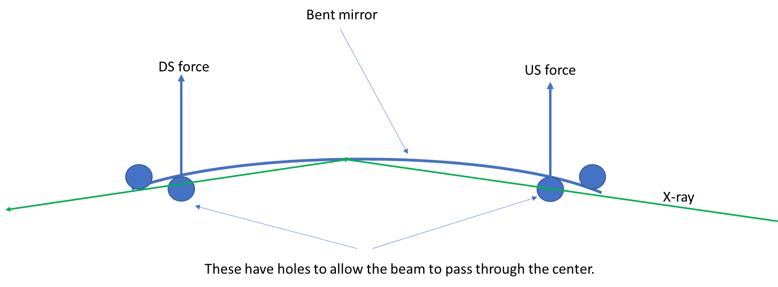
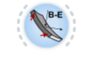
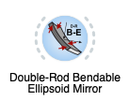
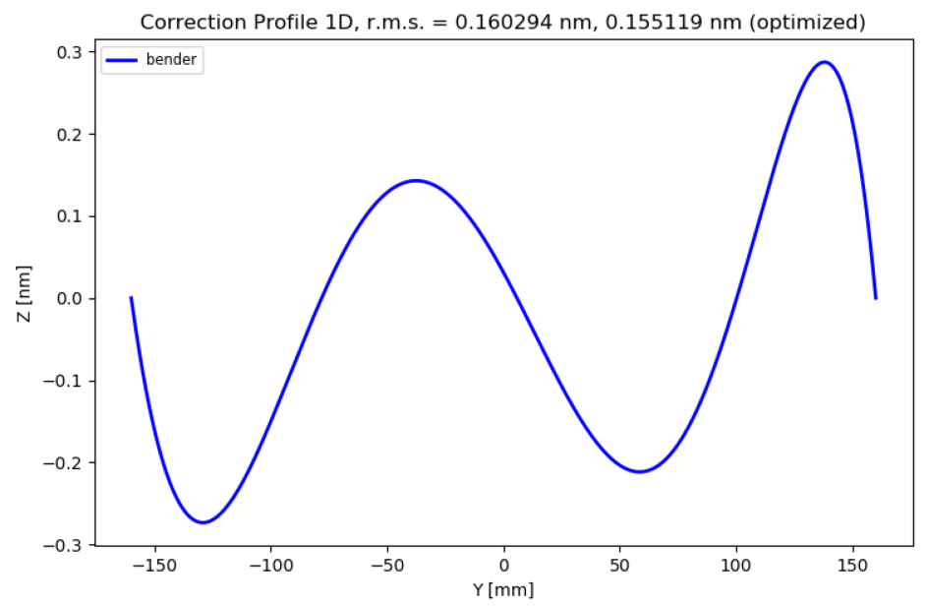
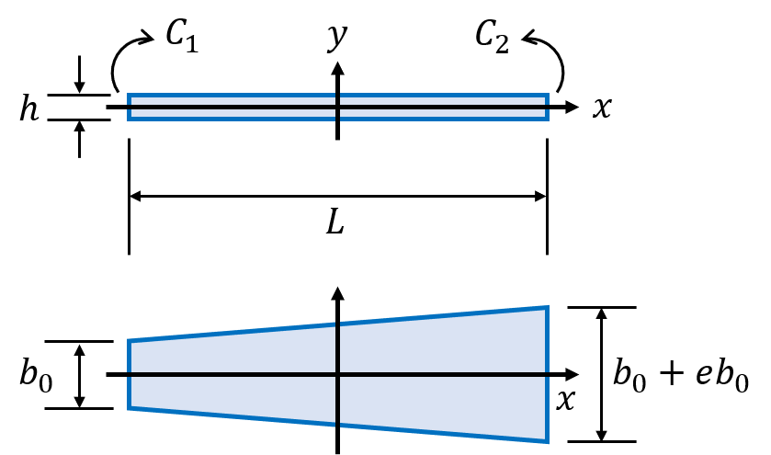
Introduction to OASYS
Simulation of realistic Mirrors
Bender vs Ideal profile
Bender error
Bendable Elliptical Mirror

Slide 18
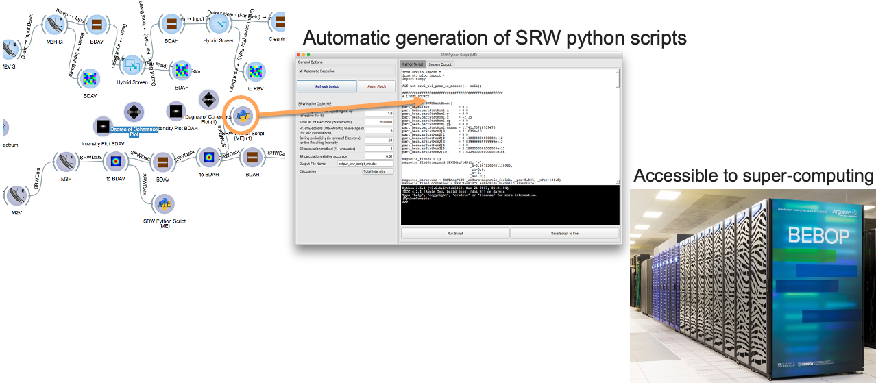
Introduction to OASYS

Slide 19
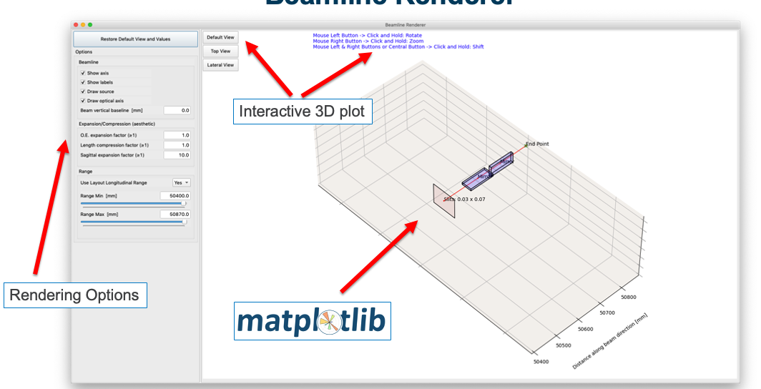
Introduction to OASYS
Beamline Rendering

Slide 20
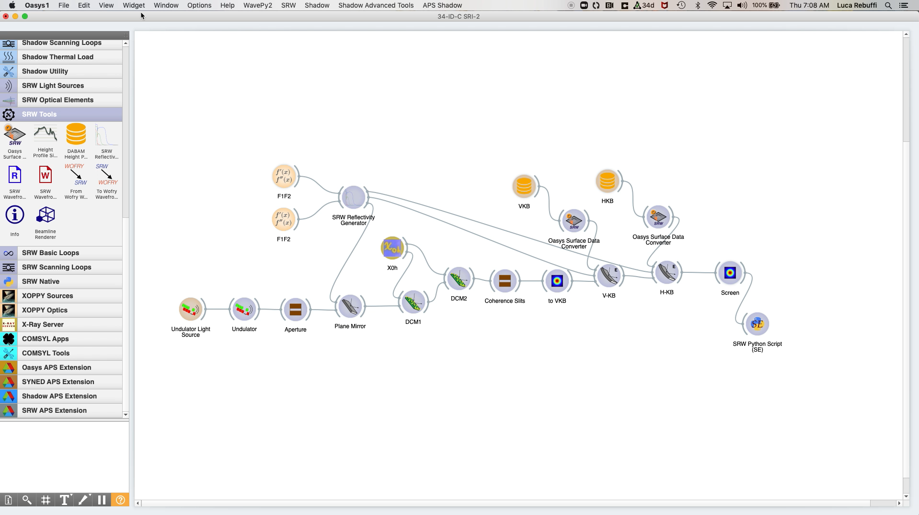
Introduction to OASYS

